Slide 1
REDEFINING mental health solutions
Starter hacks 2019
| Presented by team: MIND MEMO

Slide 2
problems
Suicide increase
Inaccurate self -assessment
Long queue times
Notes:
Problem:
Mental health → Suicide rates increase
Due to lack of wellness tracking, Inaccurate self-assessment
TIME - Long wait times, Short appointments (10 mins)

Slide 3
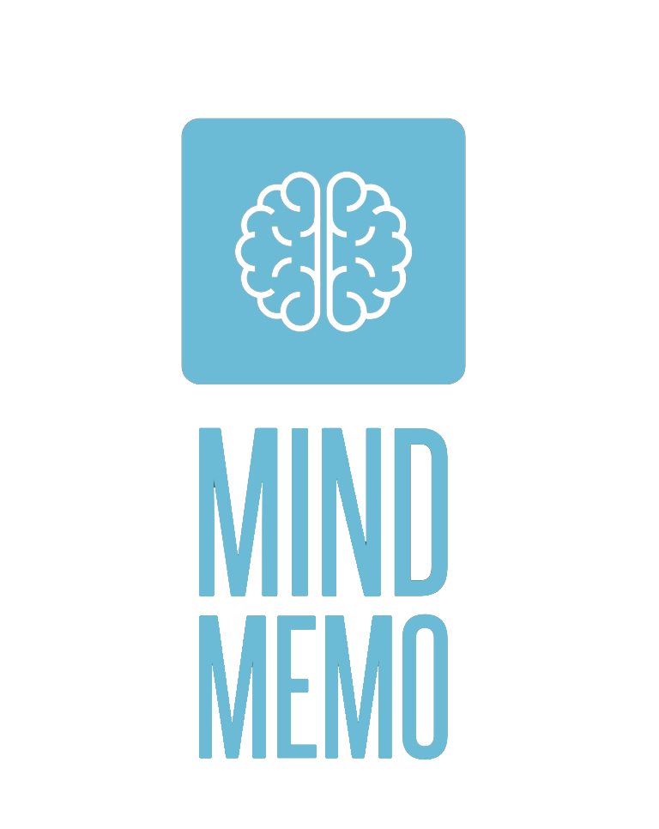
Notes:
Hook
Problem/Situation
Idea
Benefits
Provide numbers → Strongest argument
Call-to-Action
Please vote for us, etc.
If you have 2-3 minutes
Hook
Situation
Problem
Idea
Mention Marketing Strategies/ Financial Projections if there’s time
Benefits
Team
Call-To-Action

Slide 4
THE Mind memo solution
app user interface
(patients)
Web user interface
(health professionals)
Report summary
pdf
Notes:
Idea: Health & Wellness, Application and Web-based service made for mental illness patients. to journalize their daily health logs.
Our service then accesses these daily logs and condenses the entries to create health report summaries for doctors and medical caregivers, to read beforehand for appointments
This will - Improve efficiency, reduce wait times → For healthcare professionals
Used by suicide hotlines as well to reduce long queue times in urgent demand → Potential to save more lives

Slide 5

Notes:
It’s not always so easy to get help or speak to someone, we are providing a platform by which mental patients may indirectly speak to a health professional at their convenience 24/7.

